Slide 1
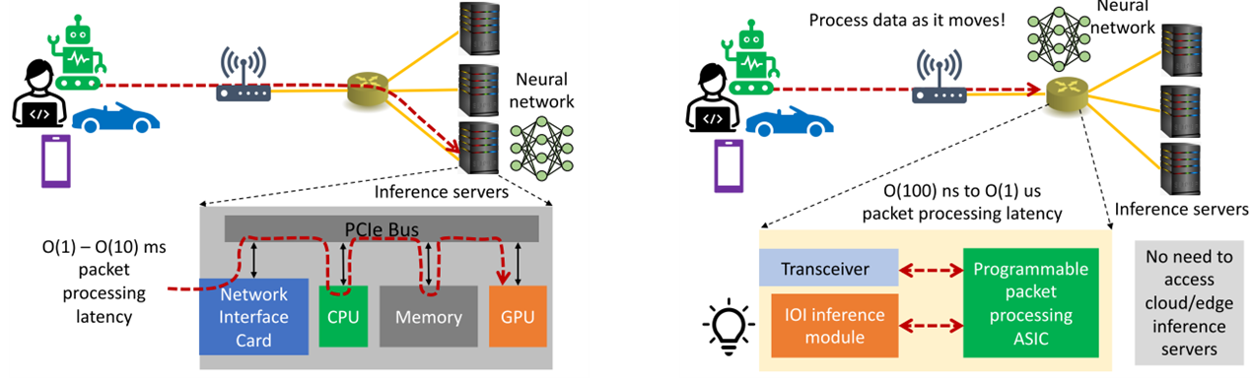
Notes: IOI: In-network Optical Inferences ^{[1]}
I. Applications
Execute neural network inference in the cloud or on edge servers.
Latency | Causes | Solutions
Packet propagation and queueing delay on the network datapath | The length of the datapath between users and the inference server. | “The closer the server the better”
Packet processing delay at the end-host inference server(s) | TCP sockets and the host server’s CPU computing capabilities to process the arriving inference queries. | This paper: In-network Optical Inference (IOI) using optical neural network (ONN) on switches.
II. Challenges
Traditional switches have limited resources to perform intensive computation such as matrix multiplication.
III. Methods-Framework
user → switch → user
user → network→ server →network → user
IV. Conclusions
* Potentially, 1000× faster than a CPU core.
* Provides new and exciting opportunities to design the next-generation machine learning systems with in-network computing for line-rate processing and ultra low latency.
(a) Today’s cloud-based or edge-based machine learning inference on inference servers.
(b) IOI-based machine learning inference on programmable switches.
[1] https://dl.acm.org/doi/10.1145/3473938.3474508?sid=SCITRUS

Slide 2
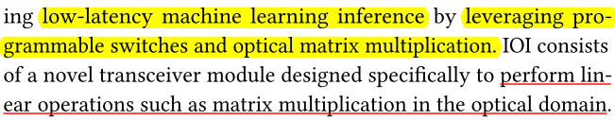
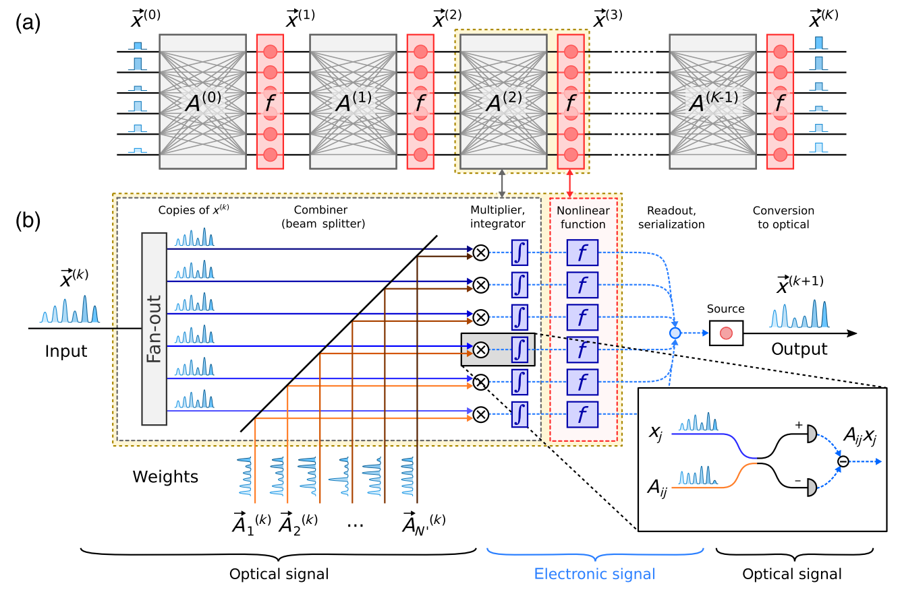


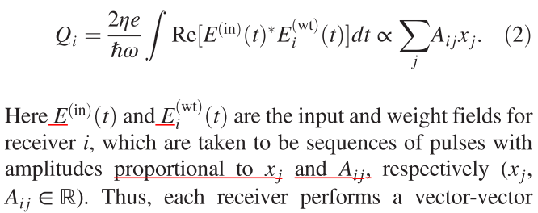
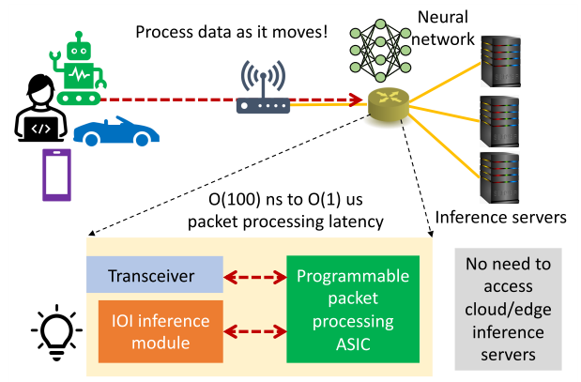
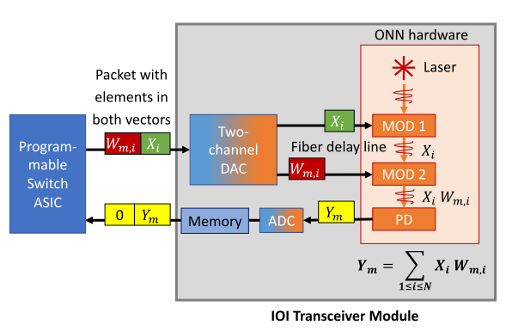
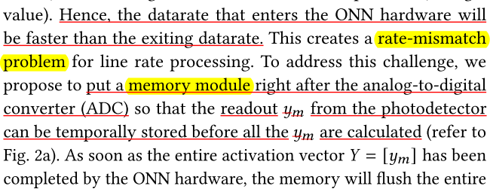
Notes: IOI: In-network Optical Inferences ^{[1]}
III. Methods-
Neural Network
(NN)
Optical
Neural Network (ONN) [2, 3]
[1] https://dl.acm.org/doi/10.1145/3473938.3474508?sid=SCITRUS
[2] https://journals.aps.org/prx/abstract/10.1103/PhysRevX.9.021032
[3] https://patentscope.wipo.int/search/en/detail.jsf?docId=WO2020102204

Slide 3
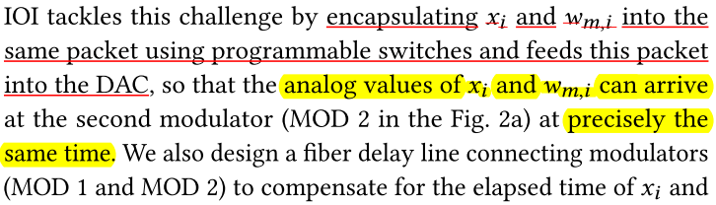
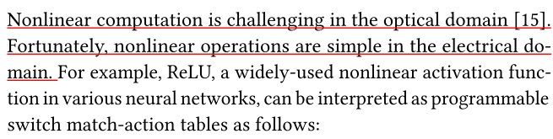
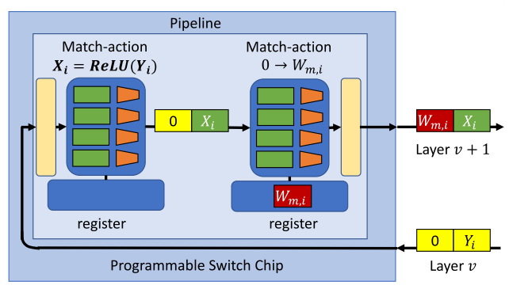

Notes: IOI: In-network Optical Inferences ^{[1]}
III. Methods
DAC
https://dl.acm.org/doi/10.1145/3473938.3474508?sid=SCITRUS

Slide 4
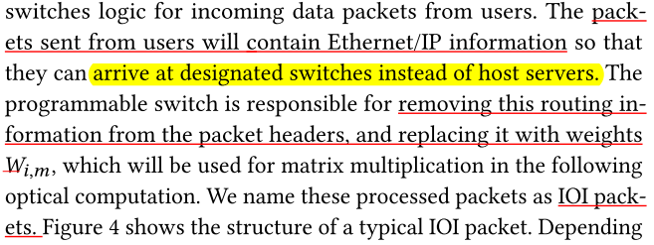
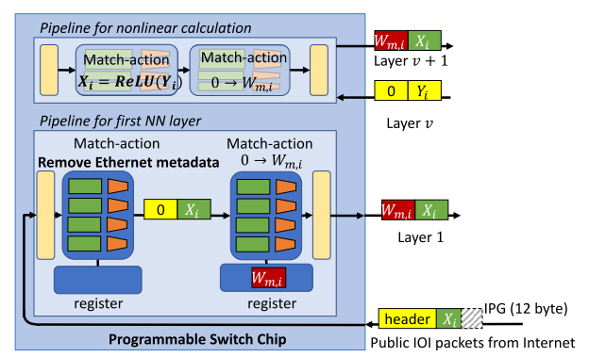
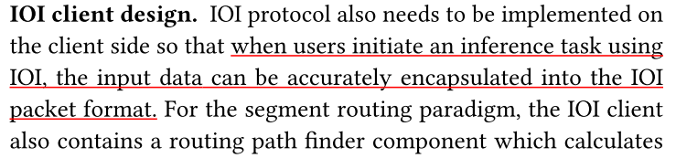
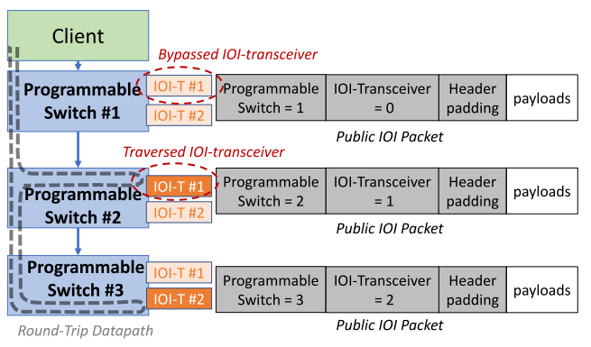
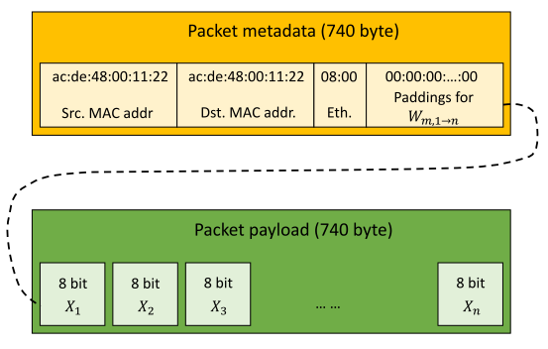
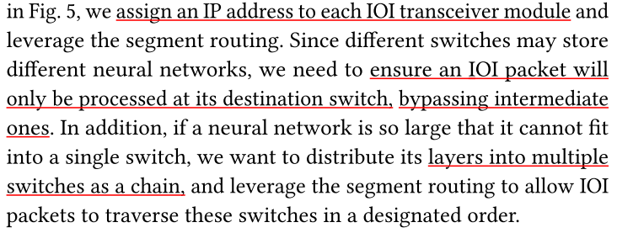
Notes: IOI: In-network Optical Inferences ^{[1]}
III. Methods
https://dl.acm.org/doi/10.1145/3473938.3474508?sid=SCITRUS

